Slide 1

My Study Partner
Made by-
Nayan Vaid

Slide 2
My Study Partner is an app to increase productivity during exam time and it help to prepare for exams

Slide 3
How My Study Partner is made?
My Study Partner is made with a JavaScript framework React Native.
The app is made under Expo managed workflow.
Why My Study Partner
My Study Partner is designed to maximize the productivity therefore it doesn’t has distracting animations or arts.

Slide 4
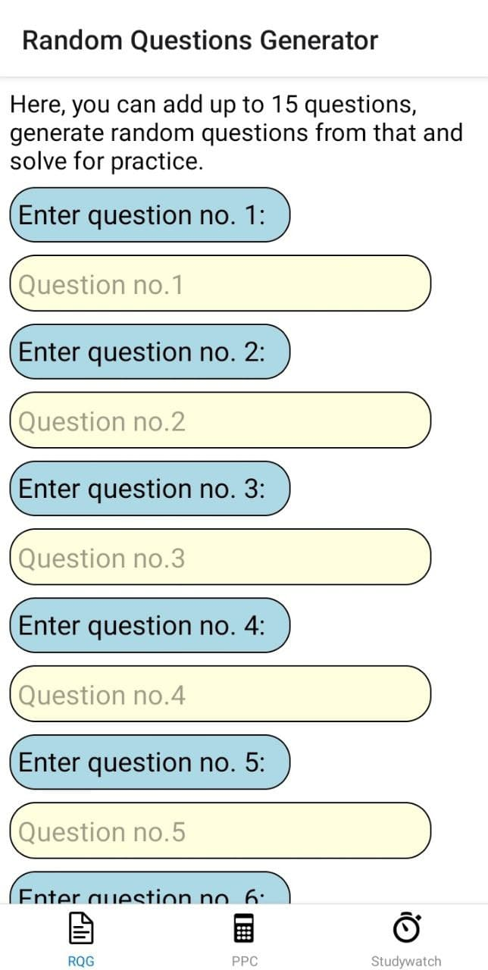
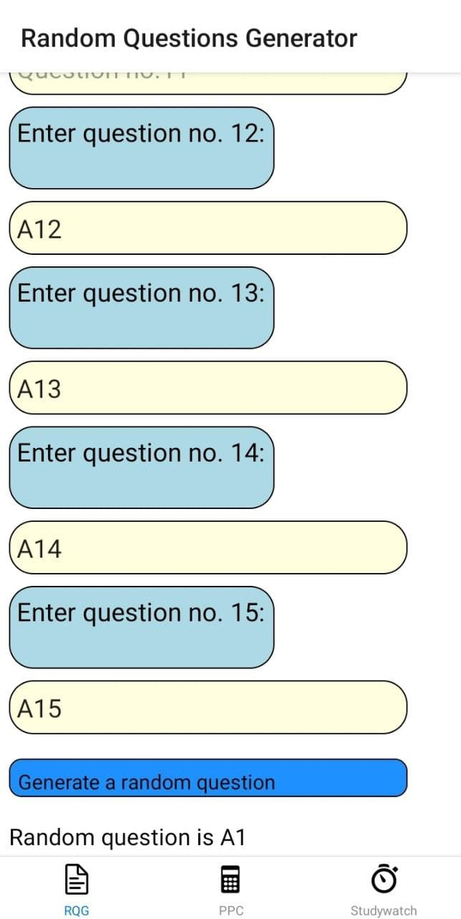
It has a random question generator that can help you generate questions to help you prepare for exams

Slide 5
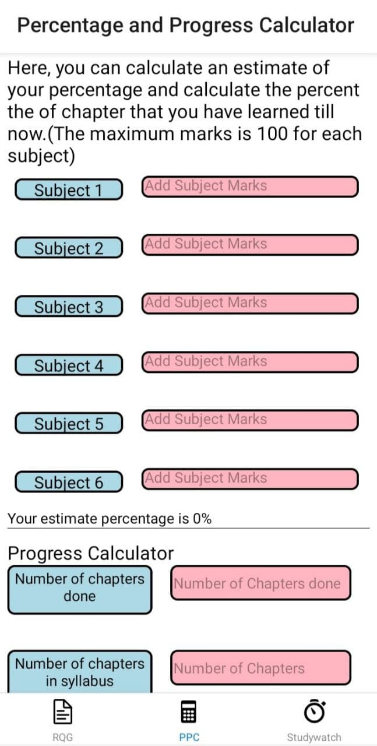
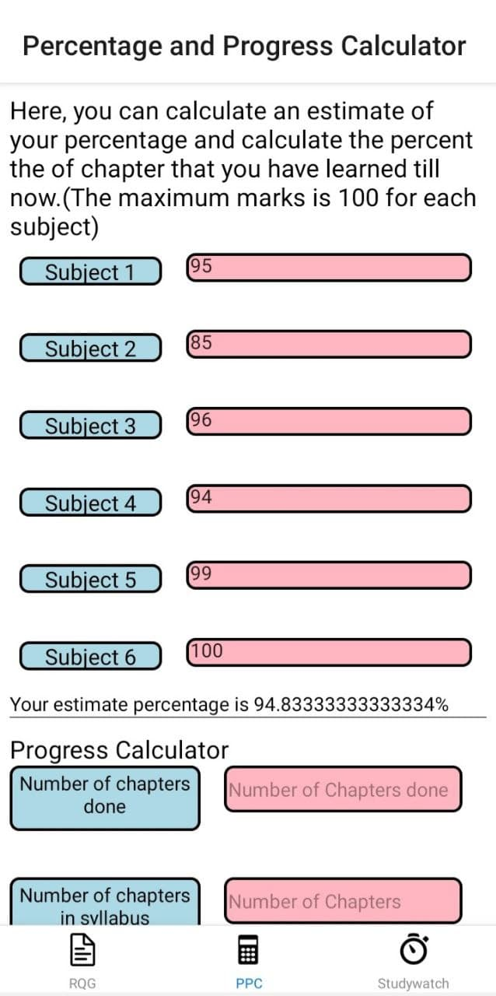
It has a percentage and progress calculator so you have an estimate of your percentage.

Slide 6
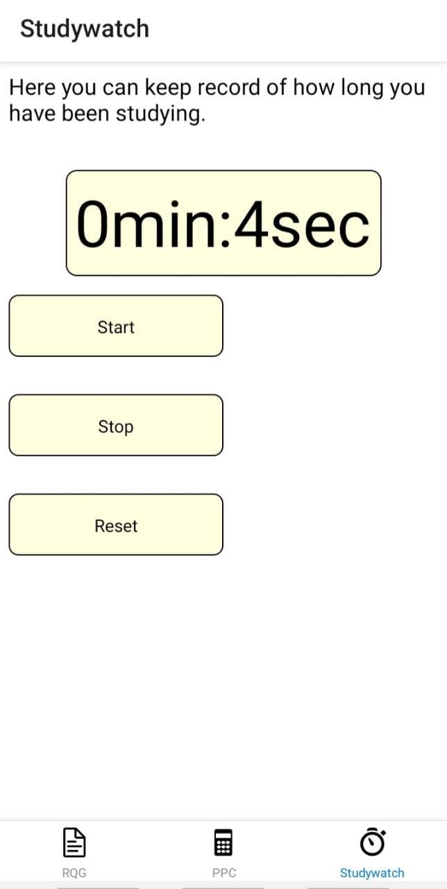
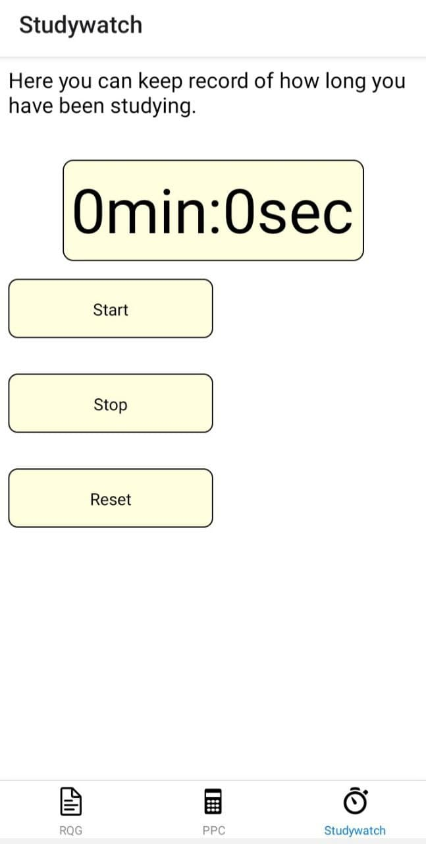
It has a Studywatch so that you can study and rest efficiently and boost your productivity.

Slide 7
Thank you for reading!

